Slide 1


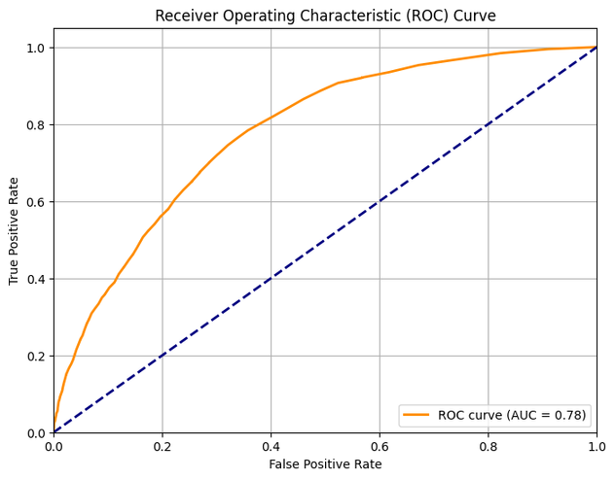
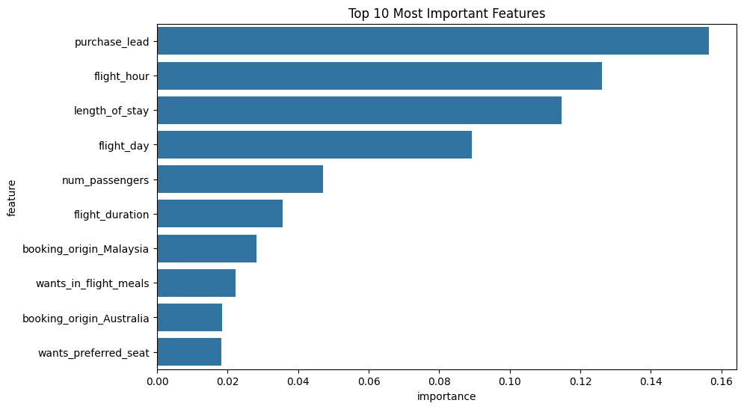
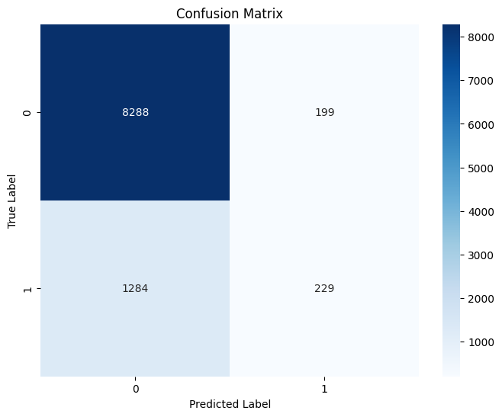

Model Evaluation
Feature Importance Customer Behavior
ROC-AUC : 0.78
Accuracy: 0.85
TRI AJI PRAKOSO

